Slide 1


Department of Hawaiian Home Lands
Orientation Meeting
Offer #2
Kapolei High School
July 14, 2018

Slide 2
Announcements
Restrooms
No smoking
No food and beverages – please keep your area clean
Avoid distractions
Support Desk available

Slide 3
Agenda
Introduction
Ka’uluokaha’i Overview
Turnkey Program
Financing
Lot Selection Ground Rules
Award Process
Important Dates

Slide 4
Department of Hawaiian Home Lands
Welcome
Deputy William J. Aila, Jr.

Slide 5
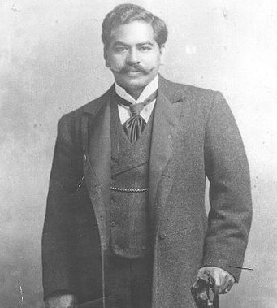
Department of Hawaiian Home Lands
Prince Jonah Kuhio Kalaniana’ole

Slide 6

Department of Hawaiian Home Lands
Land Development Division
Darrell Ing

Slide 7
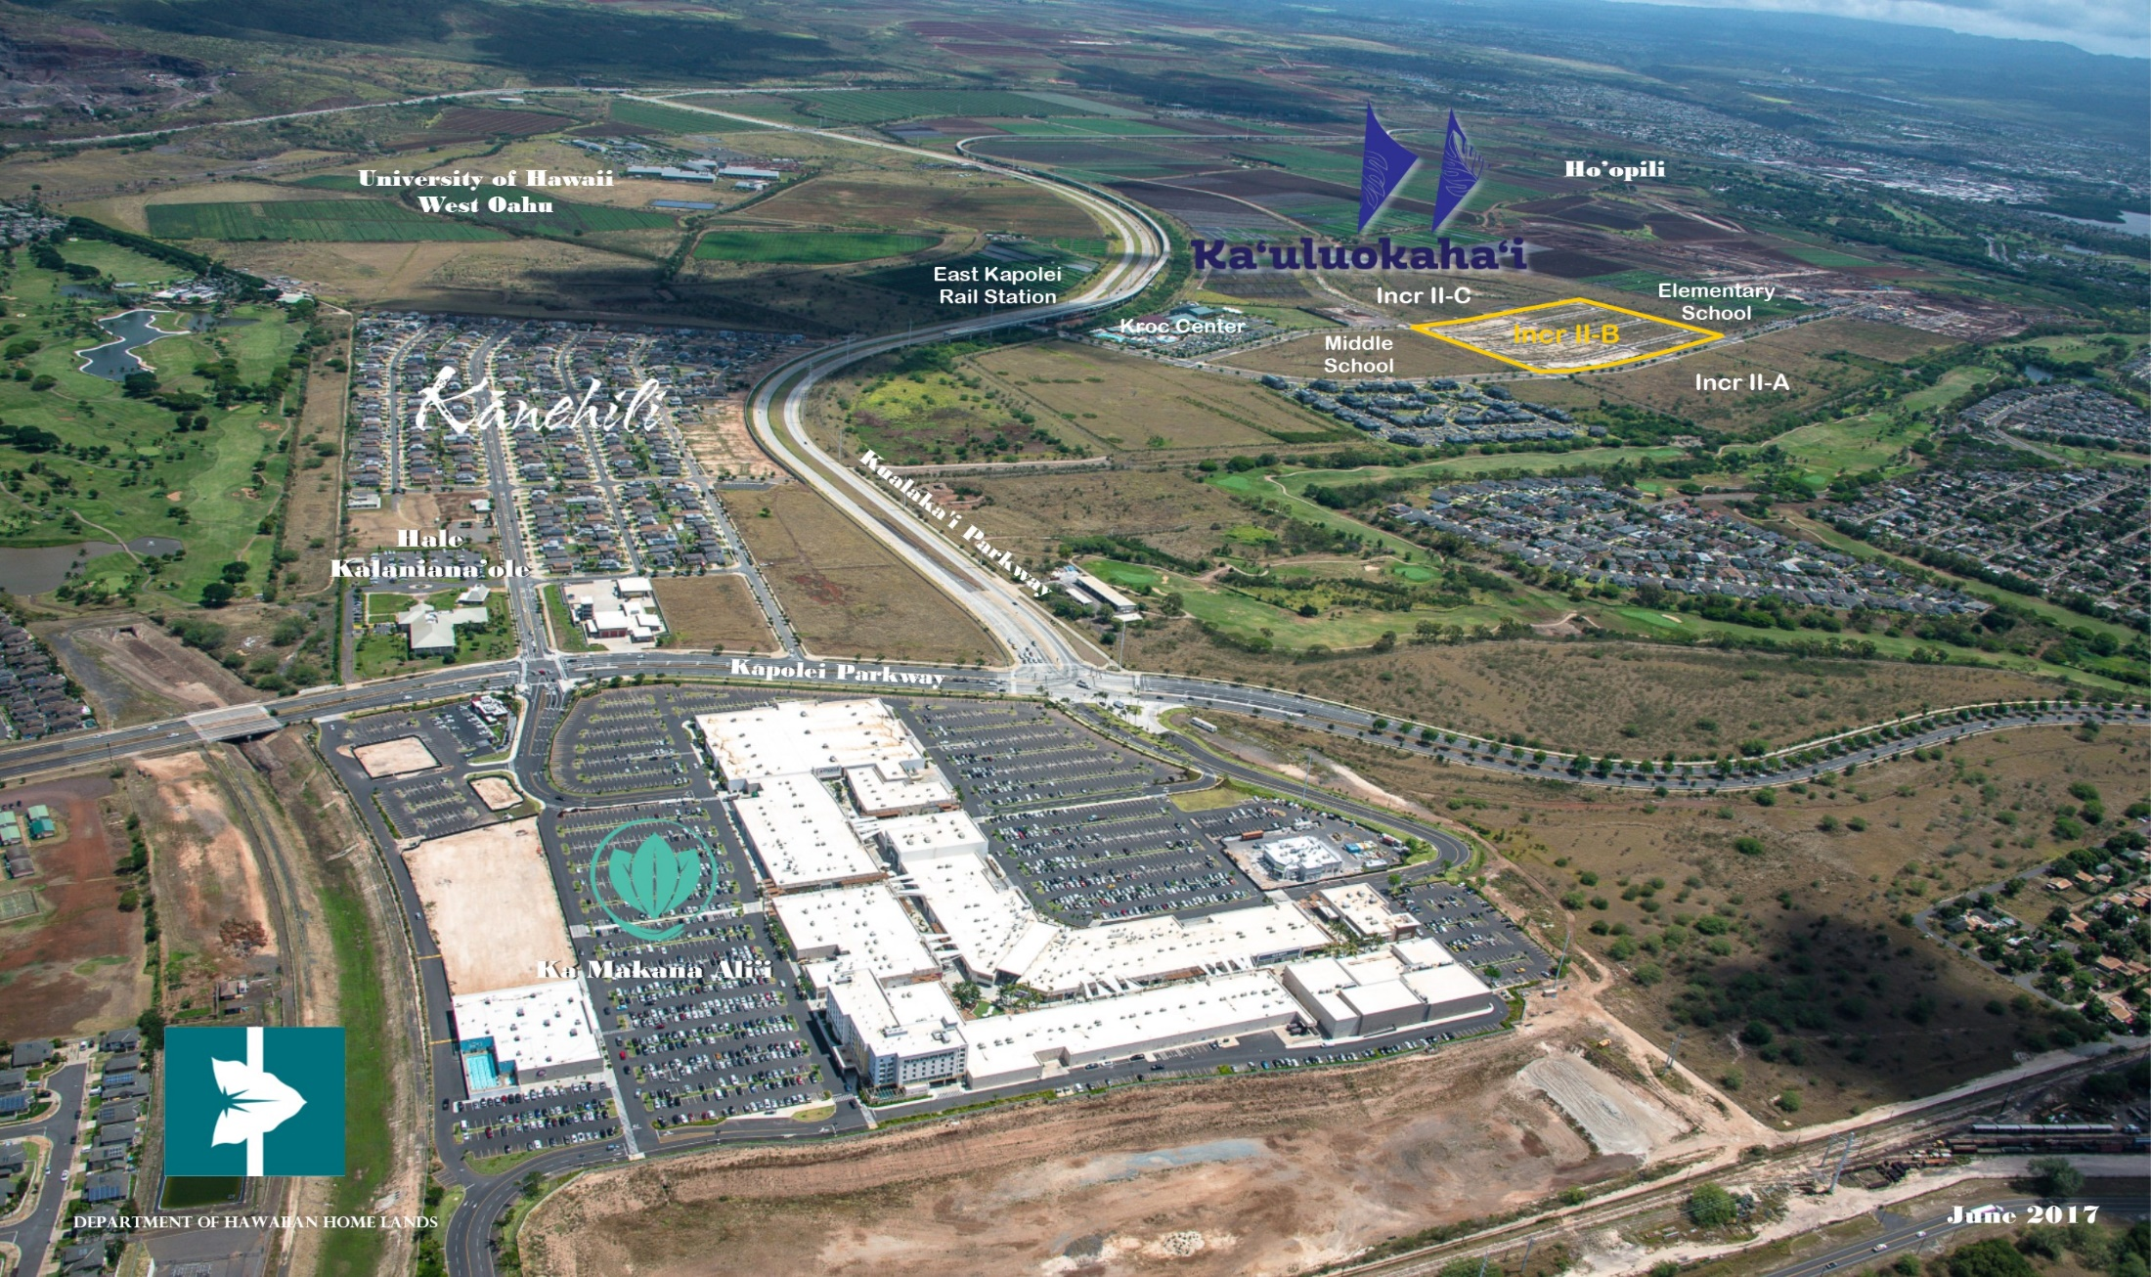
East Kapolei

Slide 8
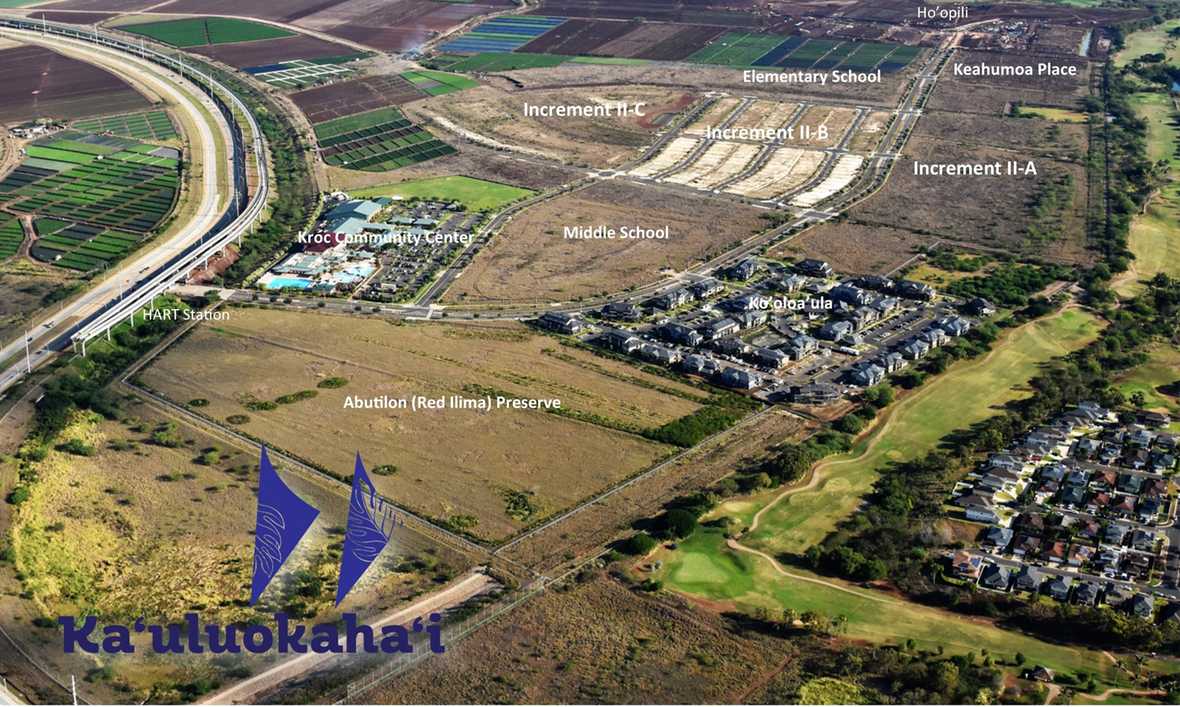
Ka’uluokaha’i

Slide 9
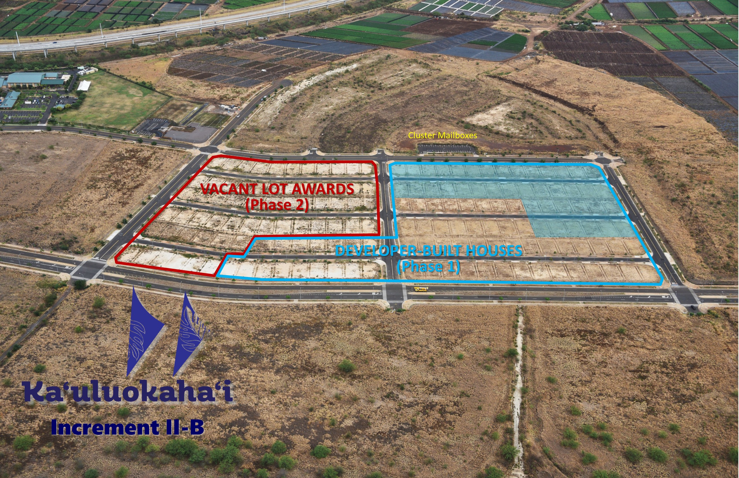
Ka’uluokaha’i, Increment IIB

Slide 10
Available Turnkey Lots
Ka’uluokaha’i, Increment IIB
100 lots have been designated for Turnkey homes
Turnkey awards are lots with pre-built single-family homes.
36 lots were selected in December 2017.
The same Lot Selection Ground Rules will be followed until all 100 lots have been offered and selected

Slide 11
Ka’uluokaha’i, Increment IIB
Construction Schedule
First offering – December 2017
  House construction started May 2018
First house complete
  August 2018

Slide 12

Project Developer

Slide 13

Tom Gentry

Slide 14


Slide 15
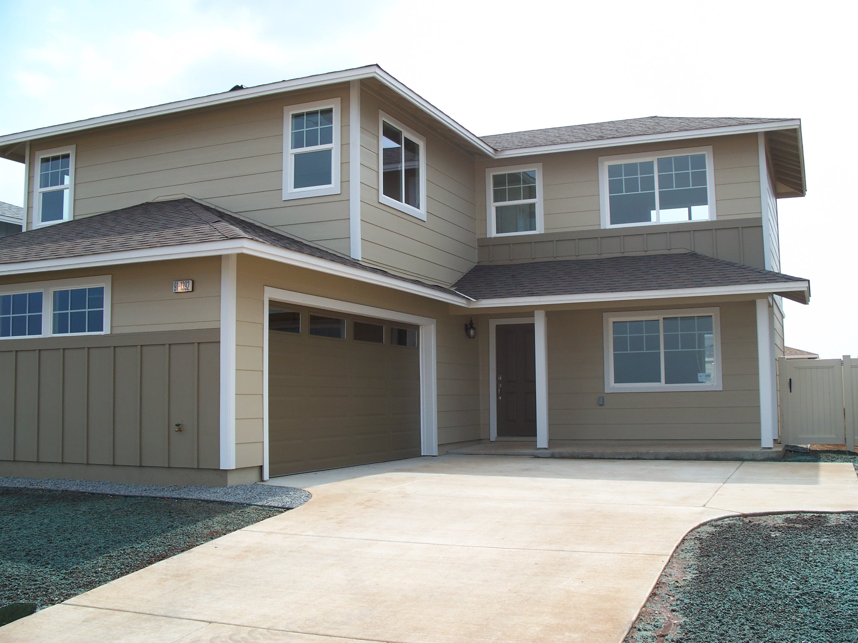
Quality Construction

Slide 16
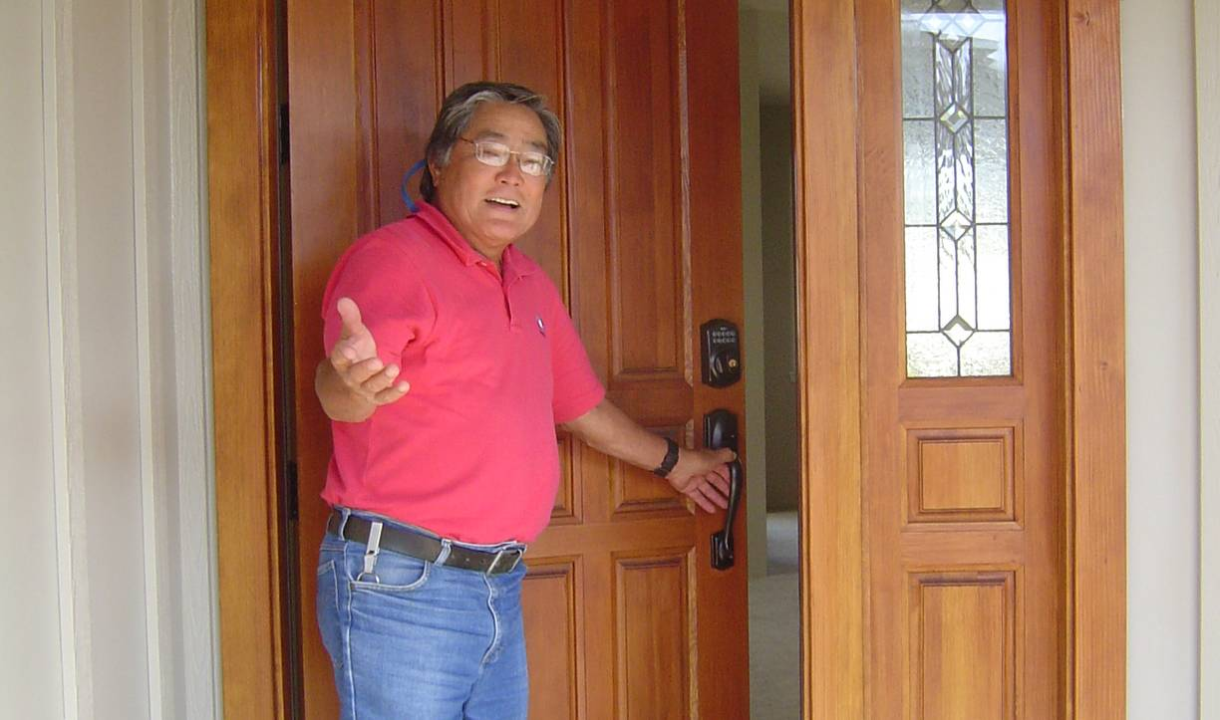
Superior Customer Care

Slide 17
An Inspired Design

Slide 18

Energy Saving Features
Low E Dual paned vinyl windows
20-SEER central air conditioning
Solar hot water heating system
Spray foam insulation
LED light package
Insulated roll up garage door with remotes

Slide 19

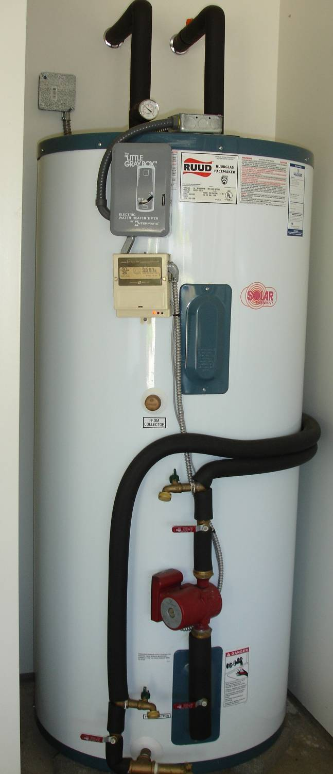
HECO approved
solar water heater

Slide 20
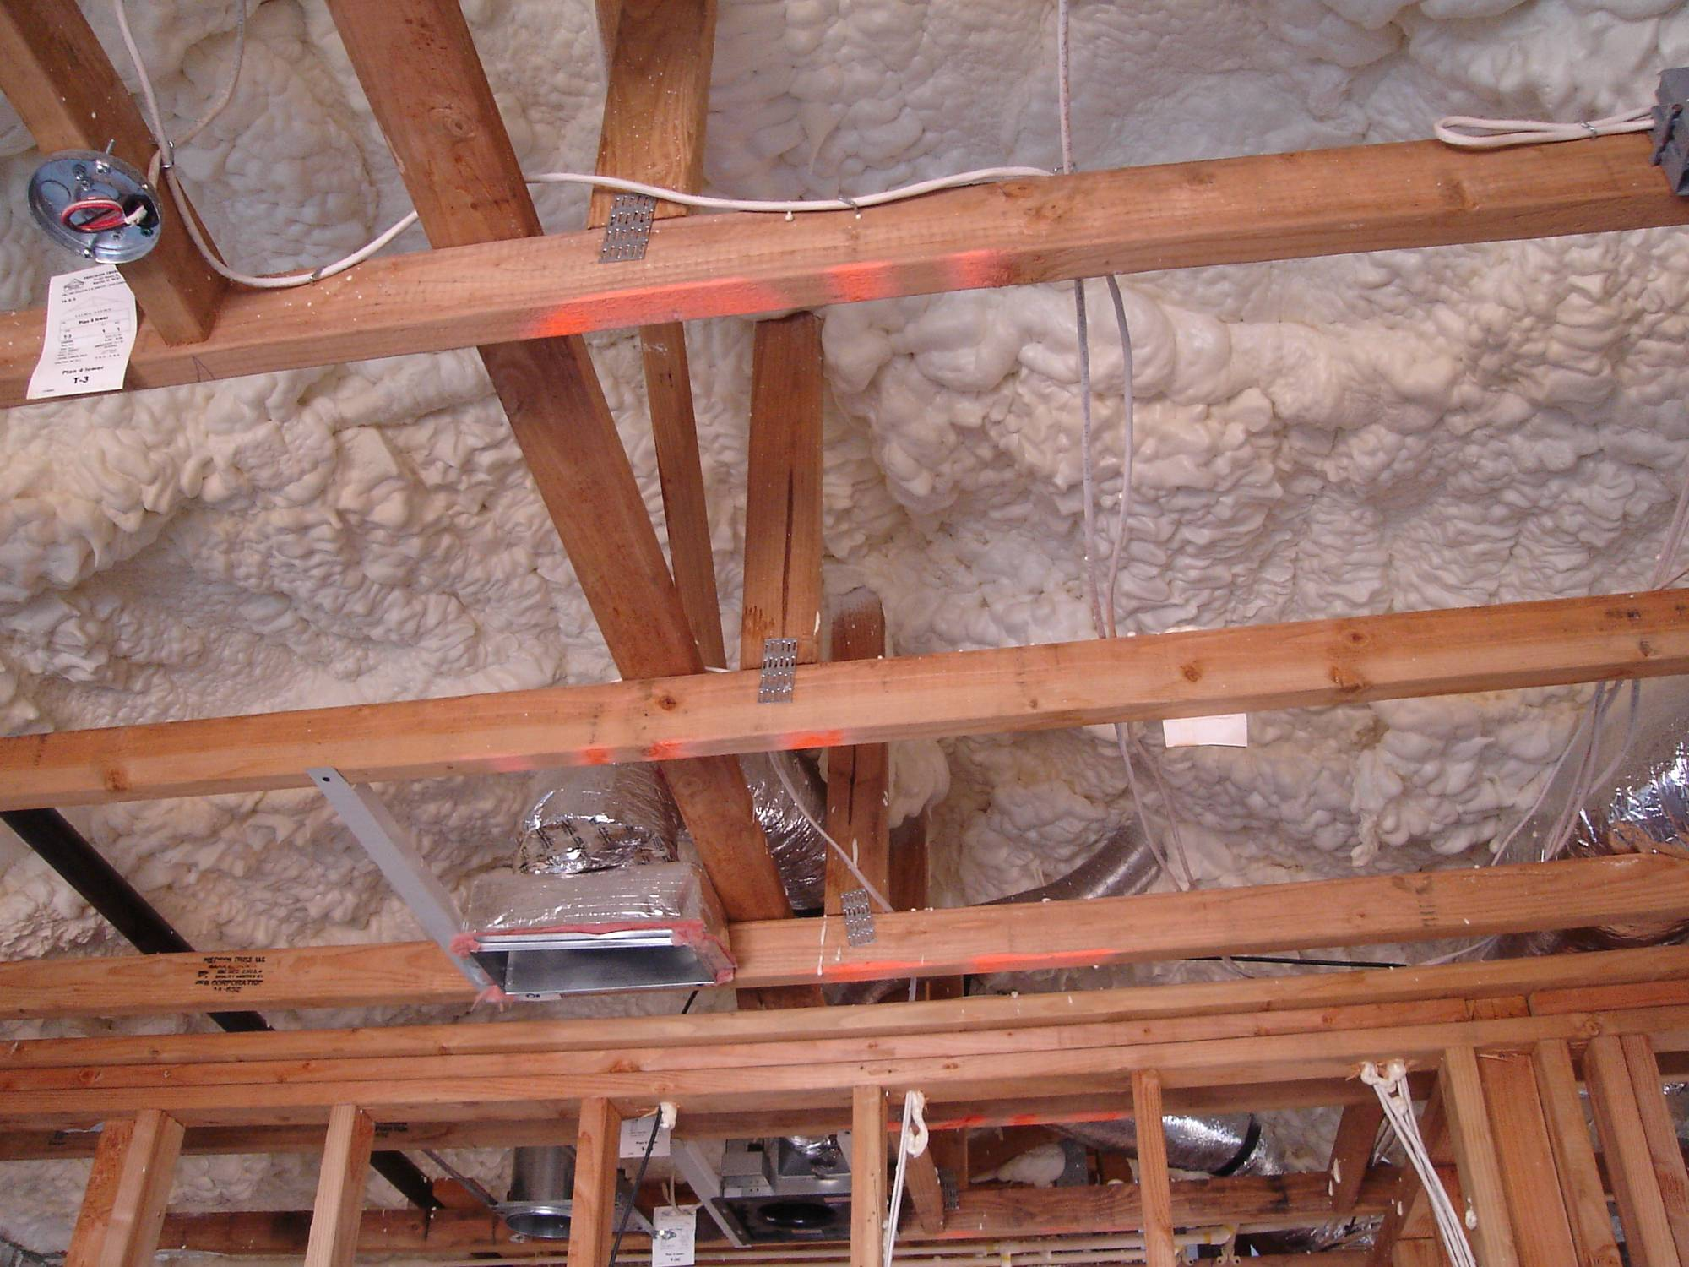
open cell foam insulation

Slide 21


Slide 22
Kitchen Appointments
GE ceramic top electric range with self-cleaning oven
Ge Microwave/hood
GE dishwasher
Designer laminate kitchen cabinets
Stainless steel kitchen sink
Kohler plumbing fixtures

Slide 23
Comfort Features
Wall to wall carpet
No wax resilient vinyl flooring at entry, kitchen, bathrooms
Spacious walk-in closet in master bedrooms
Dual wash basins in master bathrooms (except Plan A & B)
Mirrored sliding closet doors (in select rooms)
Corian bathroom vanity tops

Slide 24
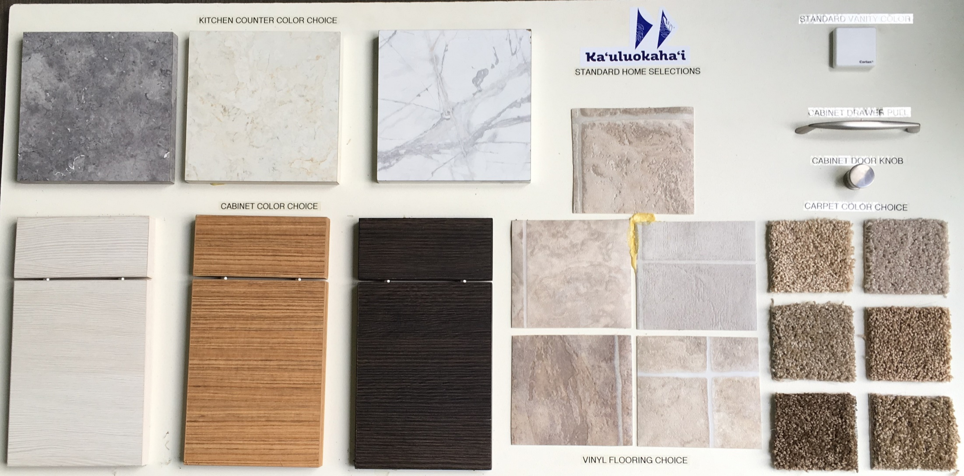
Standard Selections

Slide 25
Telephone and Cable
Pre-wired for ceiling fan in living & all bedrooms
Category 5 telecommunication wiring throughout home
Phone & cable outlets in kitchen/living & all bedrooms

Slide 26
Warranty = Quality
30 year warranty on Borate treated lumber
Limited lifetime warranty on composite roof
30 year warranty on Hard siding
Limited lifetime warranty on vinyl fencing with gate

Slide 27
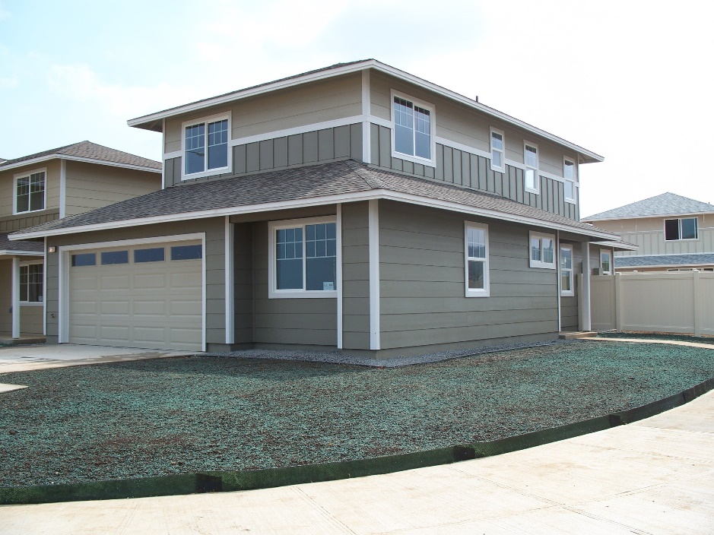

Slide 28
Value-Added Features
Front yard landscaping
Gravel edging
Vinyl privacy fence and gate
Seller incentive to use approved lender

Slide 29
Optional Upgrades
Covered lanais
Family Room
Stainless steel appliances
Washer/dryer
Ceiling fans
Flooring upgrade package
Credit to delete A/C and foam insulation

Slide 30
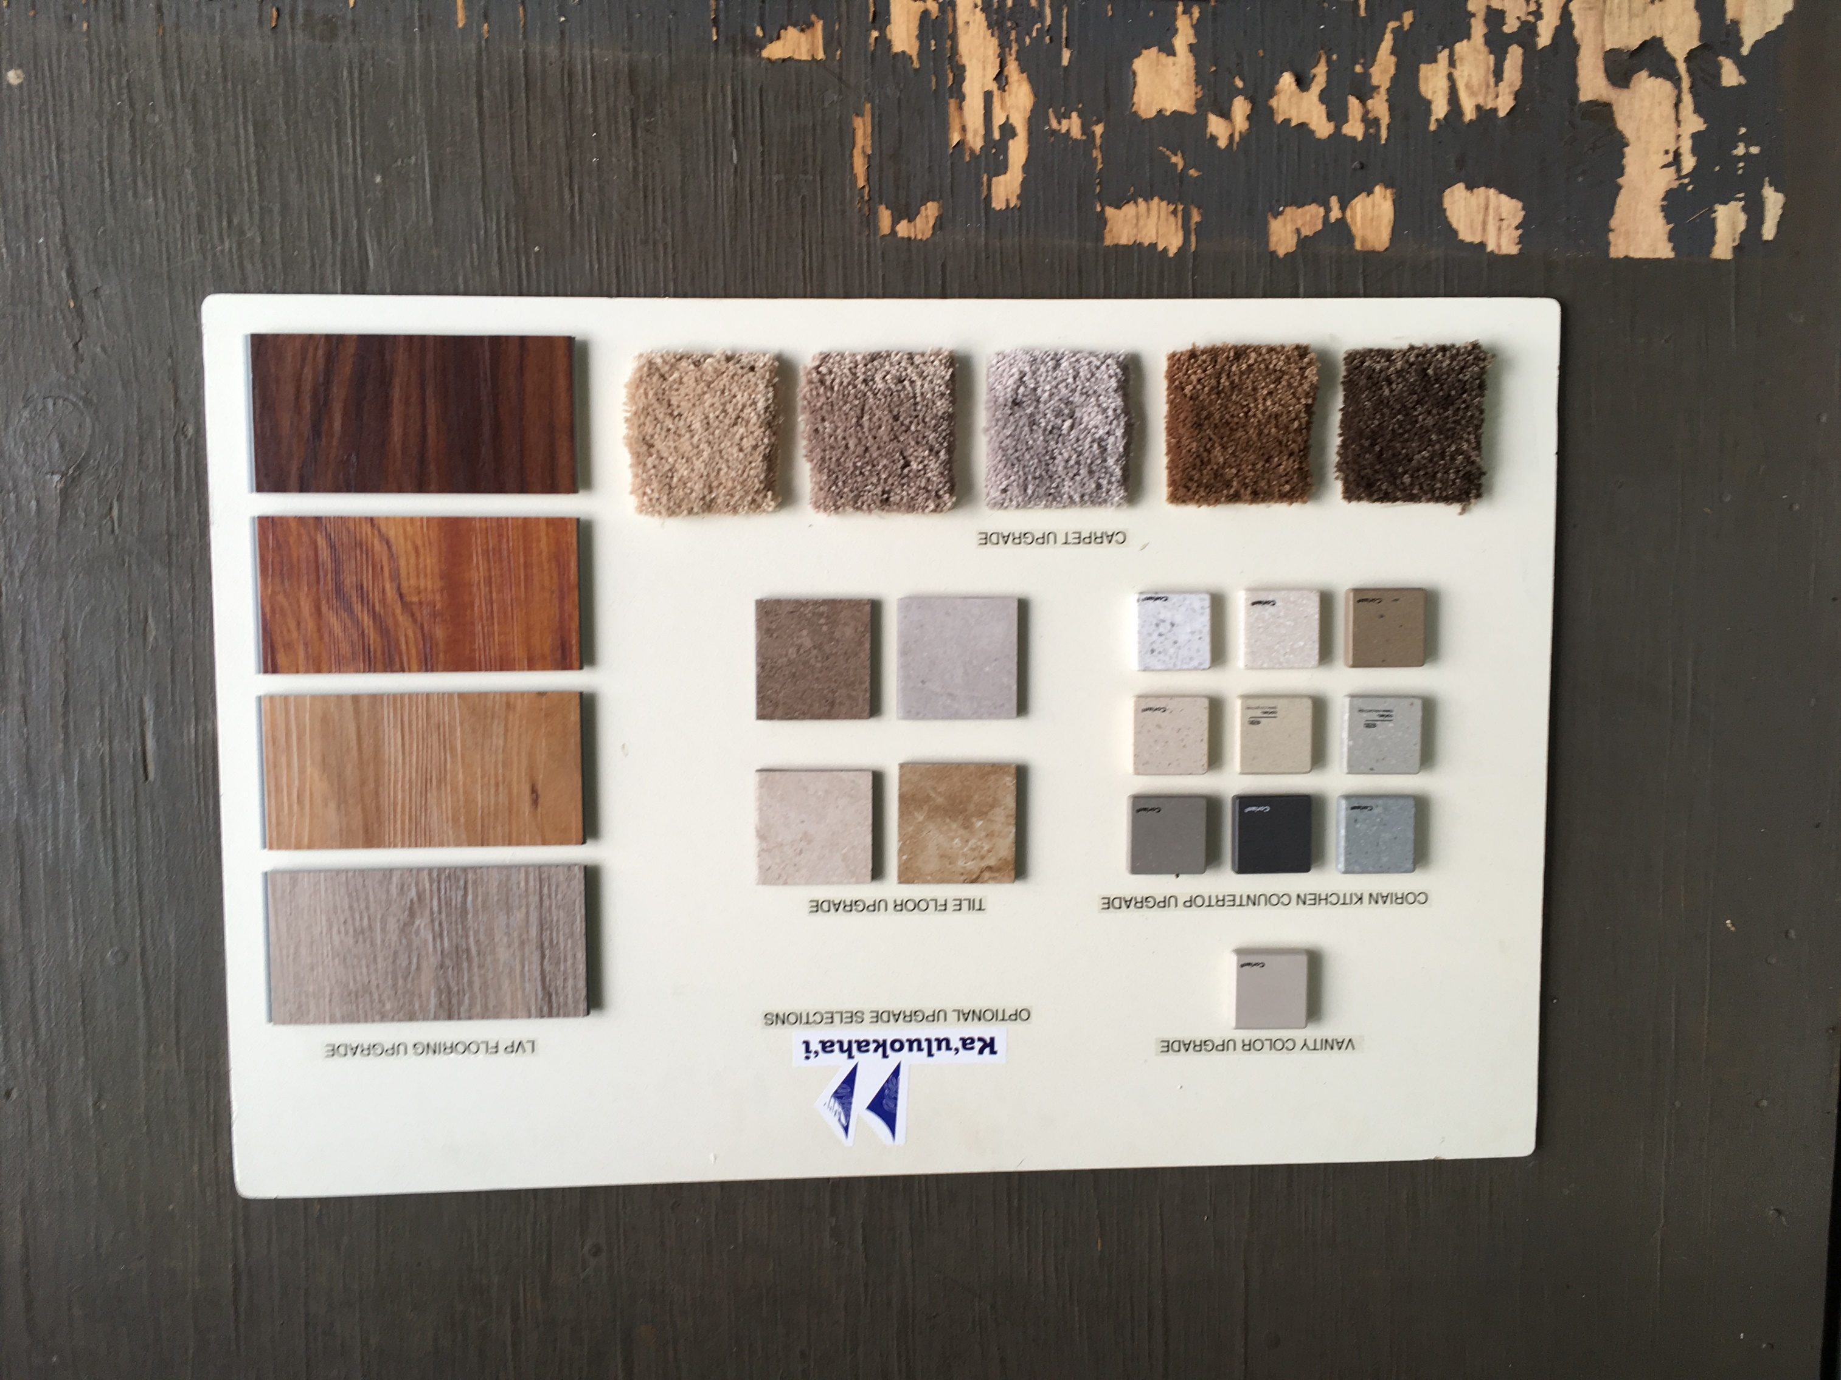
Optional Upgrade Selections

Slide 31

Project Realtor

Slide 33
Financing

Slide 34

Loan Programs and Lenders
FHA 247 & 184A
  Home Street Bank
  Bank of Hawaii
VA
USDA-RD

Slide 35
Lender Matrix

Slide 36
Transfer of Lease

Slide 37
Transfer Process
Section 208 (5) of the HHCA allows for a transfer of Lease
Transfer to any individual who is at least 50% Hawaiian and 18 years of age
Transfer to 25% Hawaiian husband, wife, child, grandchild, brother, sister, and 18 years of age
Transfer of UI currently in process must be completed by September 29 for lot selection

Slide 38
Transfer Checklist
Transfer request after lot selection (Applicant/Lessee):
  Transferee must be included in the prequalification letter.
Transfer Questions - call 620-9250
  Mention EKIIB transfer of lease

Slide 39
Turn Key
Ground Rules

Slide 40
Turn-key
Lot Selection Ground Rules
Ka’uluokaha’i Phase 1
You must be present or have a notarized authorized proxy present to select a lot for you
Bring a current picture ID (state ID, military ID or driver’s license) in order to select
Bring a copy or your pre-qualification letter in order to select a turnkey lot
If you come in after your name is called, you may select, if lots are still available

Slide 41
Turn-key
Lot Selection Ground Rules
Ka’uluokaha’i Phase 1
An earnest money deposit of $1,000 made payable to Title Guaranty Escrow Services, Inc.
An additional deposit equal to 50% of the total option amount, made payable to Title Guaranty Escrow Services, Inc., must be submitted two weeks from the date of selection
Cashier’s checks or money orders only – cash will not be accepted

Slide 42
Back Up and Deferrals
Ka’uluokaha’i Phase 1
If the lots of your choice are selected before your name is called and you want to be a back up selectee:
  Complete Back Up Request Form
  Turn the form in at the Support Desk
  Your pre-qualification letter must be attached

Slide 43
Back Up and Deferrals
Ka’uluokaha’i Phase 1
If you are no longer interested:
  Complete a Deferral Request Form (at Support Desk)

Slide 44
Awards Process
www.dhhl.hawaii.gov

Slide 45
Award Process – Lessees
Turnkey Homes
Submit response form with home preference and Prequalification to DHHL
between June 10 - August 31, 2018
Orientation meeting
July 14, 2018
Lot Selection
September 29, 2018
Submit loan application to lender within 7 banking days of contract signing date
HHC approves lease amendment and amendment to lease documents are drafted
House construction begins per developer’s build out schedule
(4-8 months to complete Per House)
Credit approval 45 days following execution of sales contract
Loan application is processed by lender
Final loan approval and house construction complete
House inspection and execution of warranty documents
You sign amendment to lease and loan documents at escrow
Chairman signs amended lease documents, then amended lease and loan documents recorded at DHHL
You receive your house keys and complete/update your Designation of Successor Form
YOU MOVE IN!

Slide 46
Important Dates
Ka’uluokaha’i Phase 1
Model Home Preference Response Form Due Date
August 31, 2018
Pre-Qualification Letter Target Due Date
August 31, 2018
Turn-key Lot Selection Meeting
September 29, 2017

Slide 47

Acknowledgements
Gentry
Engle & Volkers
Home Street
Bank of Hawaii
Helen Wai LLC
Veteran’s Administration
DHHL Staff
Deputy Aila, Dean, Juan, Carol, Michelle, Jo-Anne, Deb
www.dhhl.hawaii.gov

Slide 48
Mahalo!
www.dhhl.hawaii.gov

